Slide 1
Artificial Intelligence
A Presentation By:
Daniel Breneman
Sean Cox
Robert McConnell

Slide 2
Questions
What is artificial intelligence?
How does it affect humanity?
What can we do about it?

Slide 3

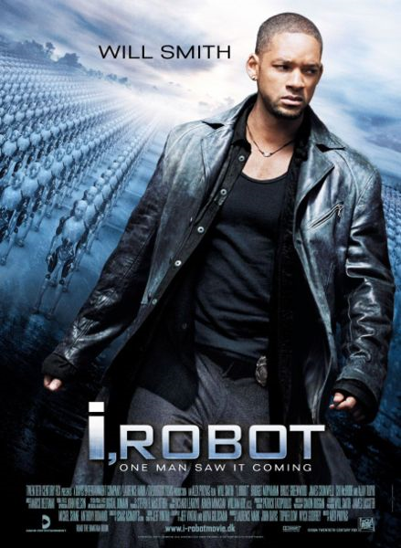
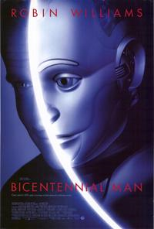
Media
Portrays AI as
Villains
Subjugators
Human

Slide 4
Definition
AI (modern)
AGI
Friendly AI

Slide 5
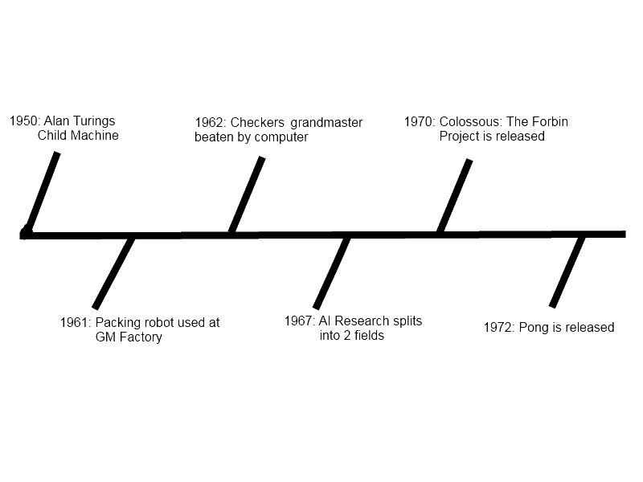
Timeline

Slide 6
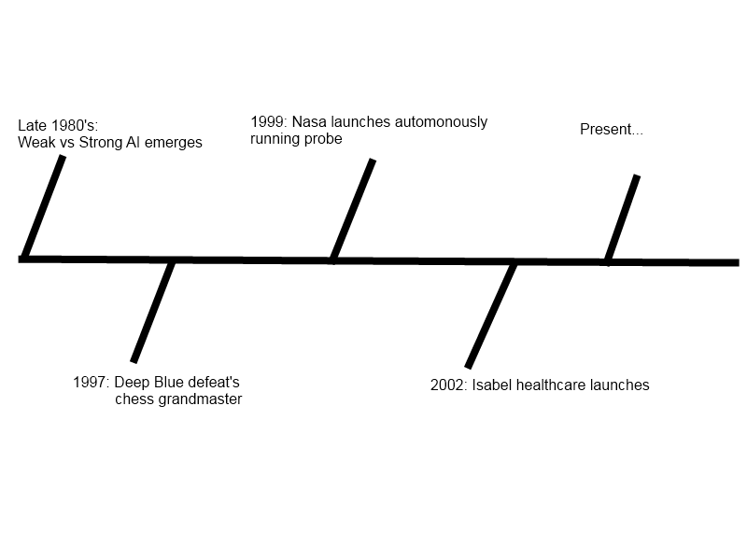
Timeline (cont)

Slide 7
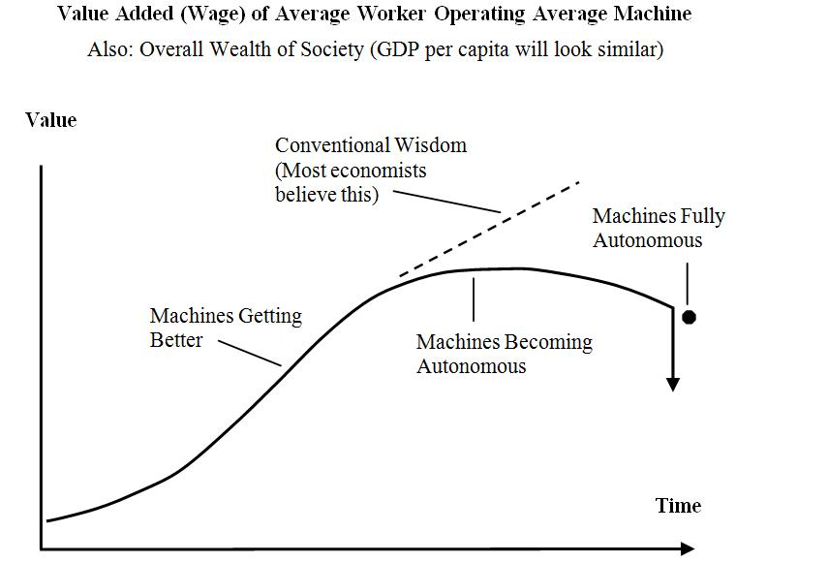
Economics
Automotive
Shipping
Agriculture

Slide 8
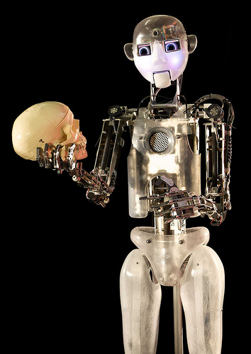
Philosophy
All about asking questions, and putting them in context
After asking questions, ask how they reflect upon yourself
Philosophy asks whether something is true

Slide 9
Common Philosophical Questions
Can a machine feel emotions?
Does an AI have a soul?
Is an AI a person?
Notes:
Emotions question: Scherer definition of emotions (reaction to input in context of previous experiences and preferences) & reinforcement learning methods that mimic it.
Soul question: Much, much more abstract, reflect mostly on wobbly definition of a soul to begin with. Say that we're not even sure if *we* have a soul. Maybe mention idea of 'ghost in a shell' style constructs.
Person question: Related to soul question, but has more legal ramifications. Maybe talk a little about ttp://www.physorg.com/news185729677.html

Slide 10
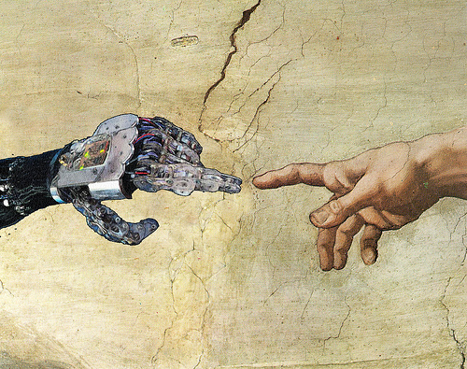
Ethics
Moral Vs. Practical
Sapient Bill of Rights
Mental Programming/Limiting
If not one, why the other?
Citizenship for AI
What is ‘Human?’
Notes:
Sapient bill of rights talk about argument for dolphins/primates rights from http://www.physorg.com/news185729677.html
Mental Programming/Limiting; talk about that kewl brain modification wave thingy device I saw on NOVA: self: find better sources damn you
What is ‘human’ talk about sentience quotient (get sources from wiki)

Slide 11
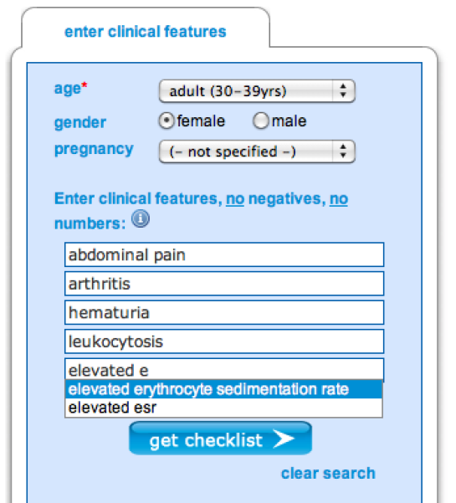
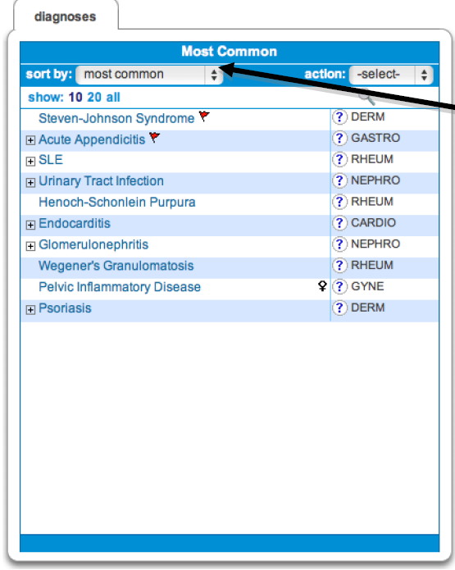
Culture
Applicable concepts for mankind since 1988
Intelligent knowledge database

Slide 12
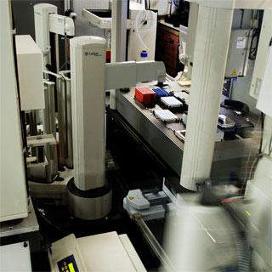
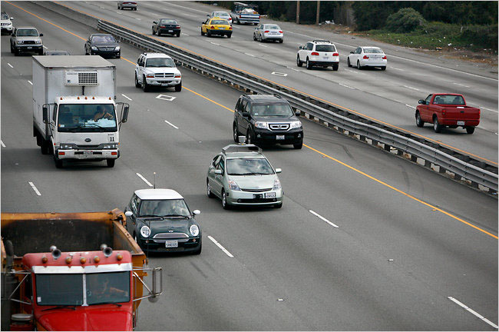
Culture
Adam research intelligence
DARPA/Google car program’s

Slide 14
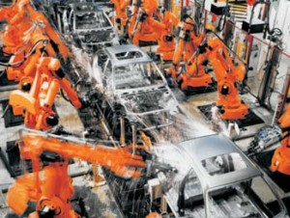
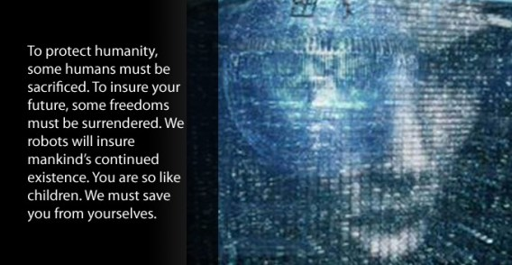
Problems
Job outlook
Rogue AI
Notes:
-Viki Picture : http://getdclu.wordpress.com/2009/08/25/making-and-controlling-a-robotic-public/
- Assembly Line : http://robotsftw.com/2009/08/so-are-robots-stealing-our-jobs/

Slide 15
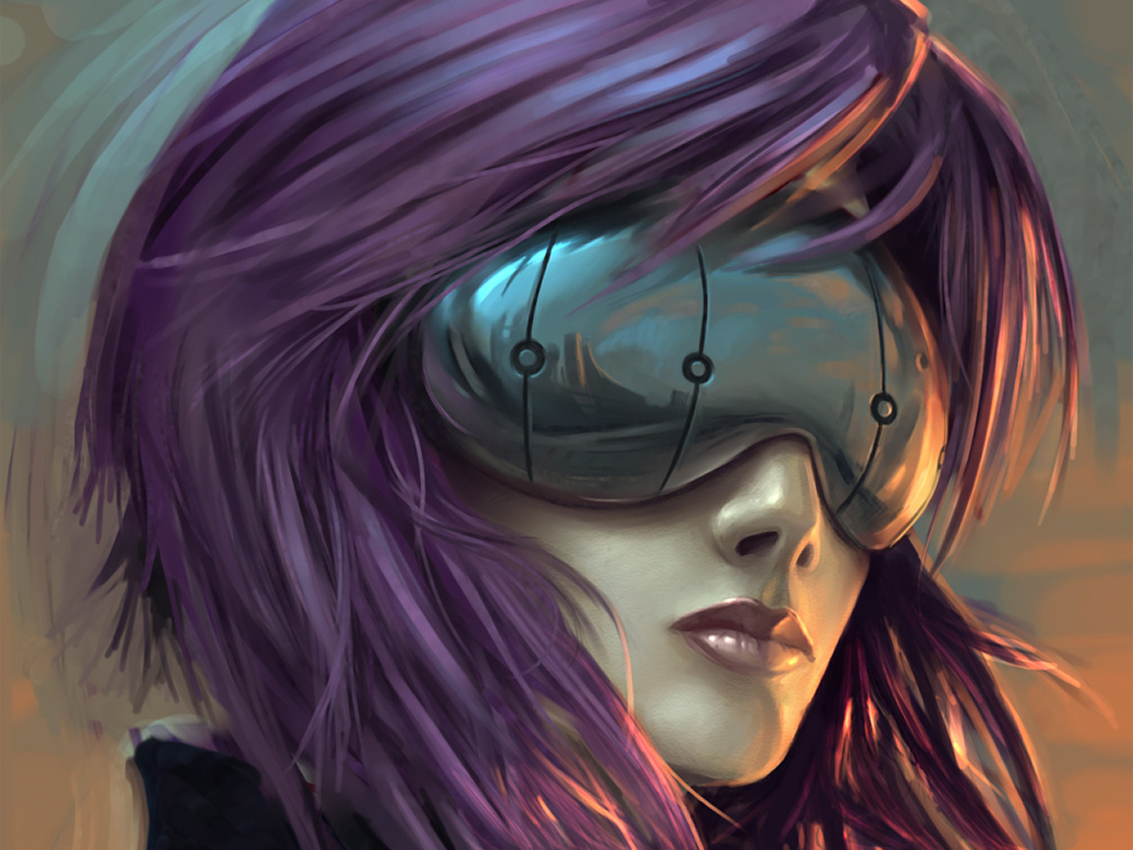

Solutions
Advance humanity
Say no to the red button

Slide 16
Conclusion
What is artificial intelligence?
How does it affect humanity?
What can we do about it?

Slide 17
References
Economics Image: http://warning.zoned.dk/

